Slide 1
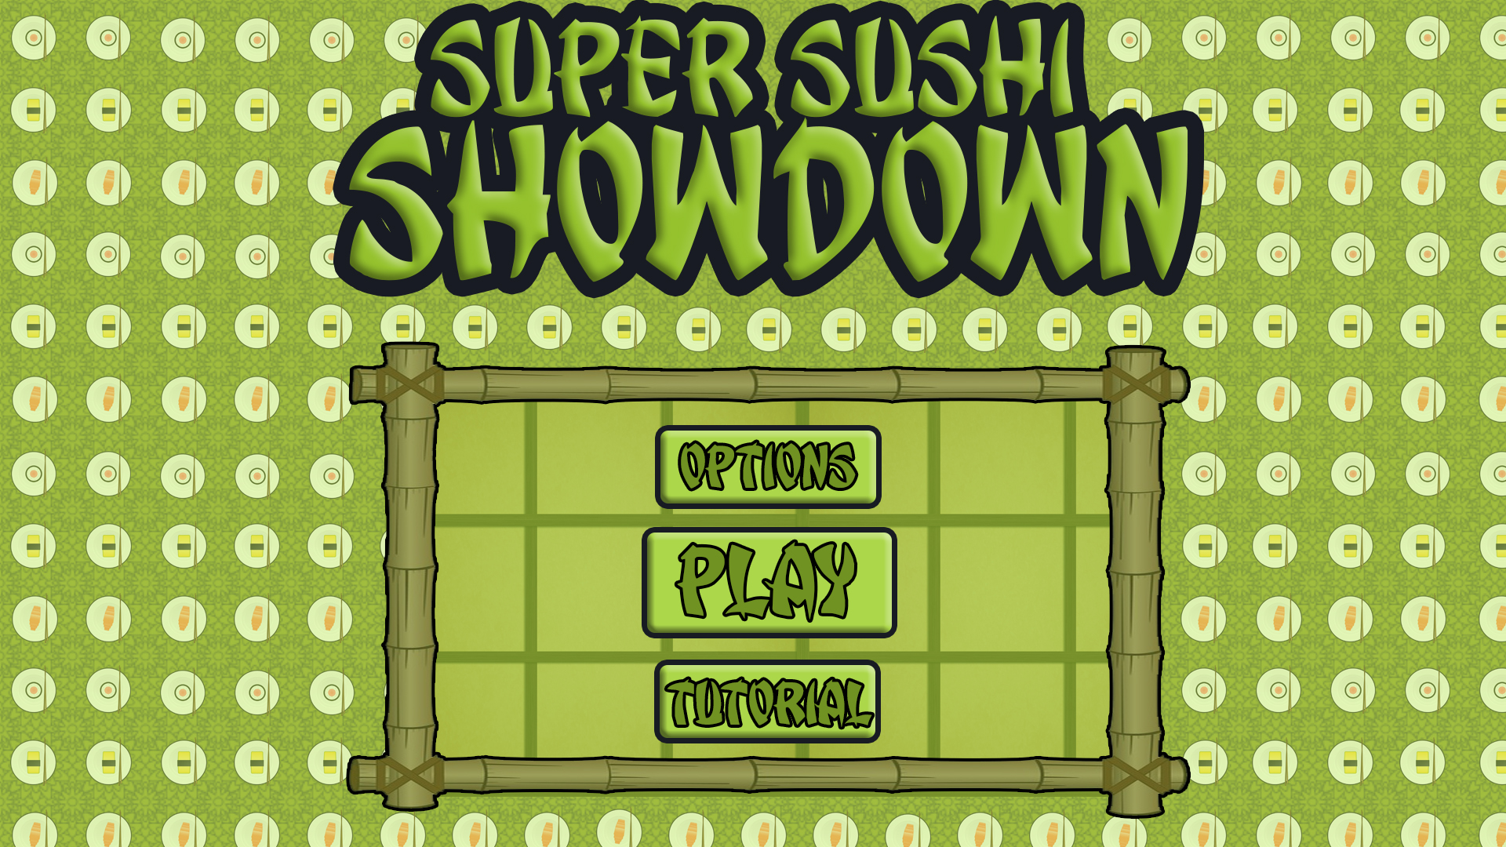
Bandai Namco Group 5 Third Pitch
Henry Crofts, Ashley Long, Samuel McMillan and Dawid Hojka

Slide 2
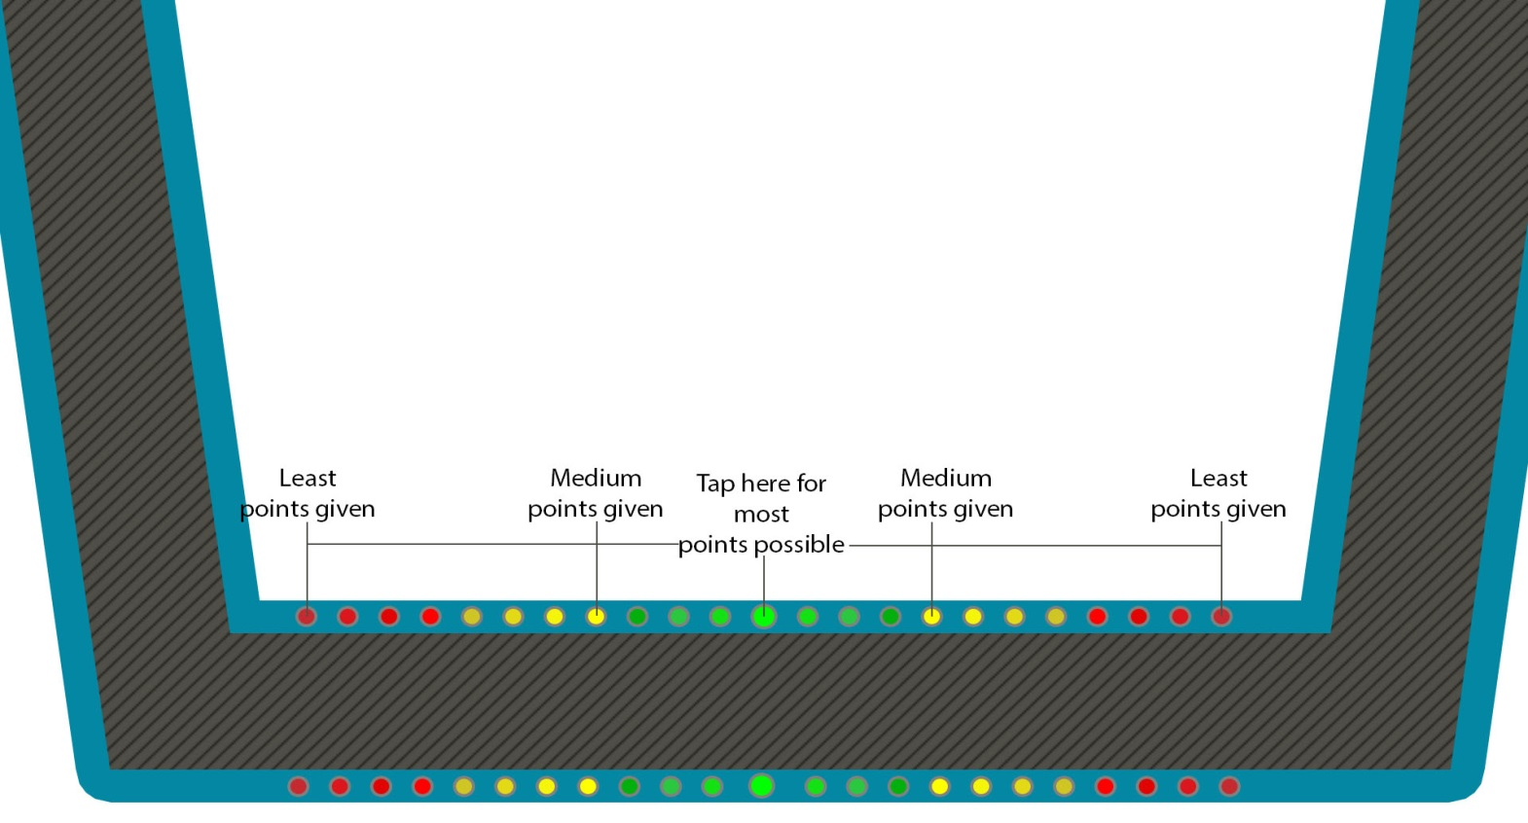
Brief Overview
Turn based
Rival sushi bars
Twitch mechanic
Score zone

Slide 3
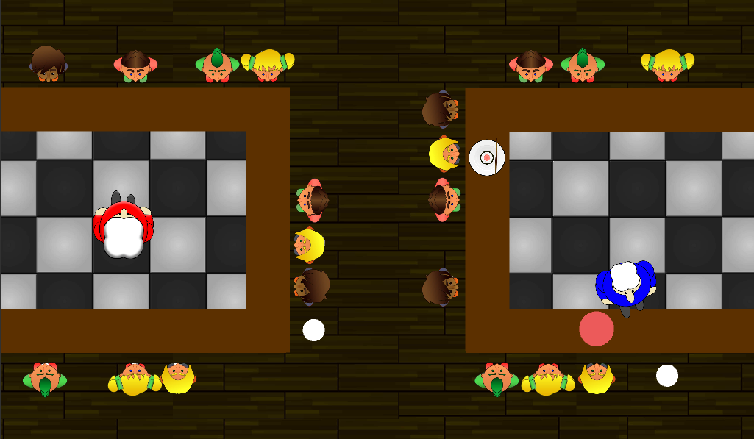
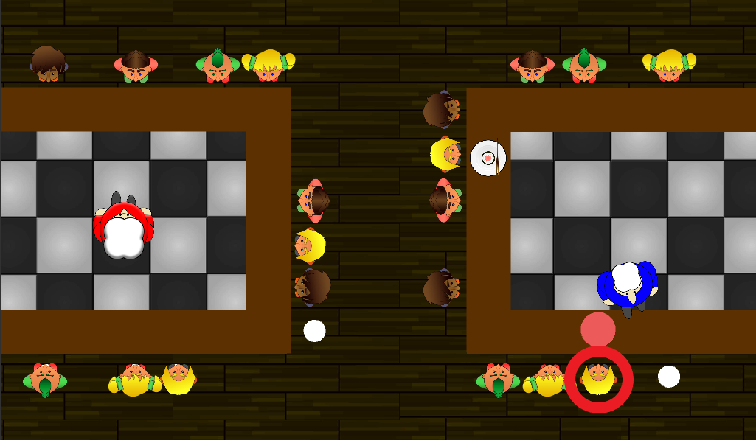

Latest Prototype / Features
Node starts to move round
Players receive a score based on their result
The score determines customer movement
Activator not visible in game
Once order complete, turns switch
Customer gets highlighted

Slide 4
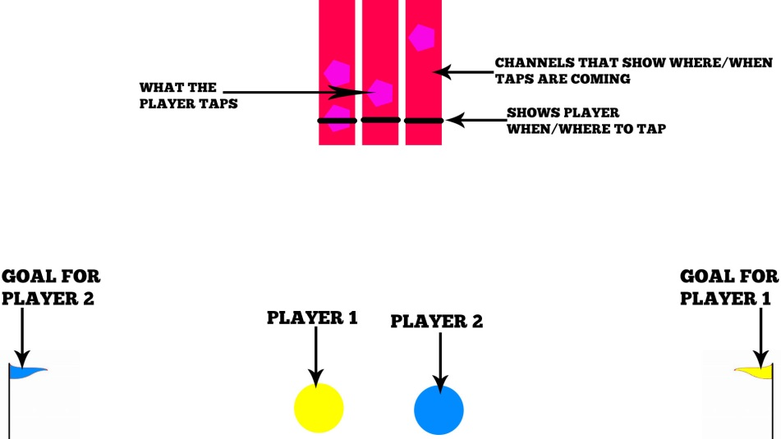
Iterations

Slide 5

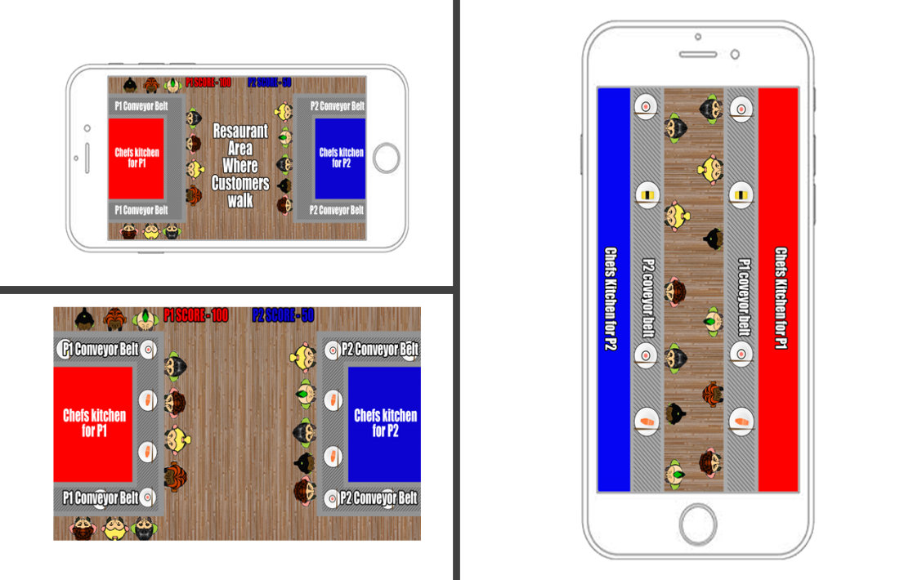
Iterations Continued
Sushi theme
Bring nodes into game
Screen space
Adversarial

Slide 6
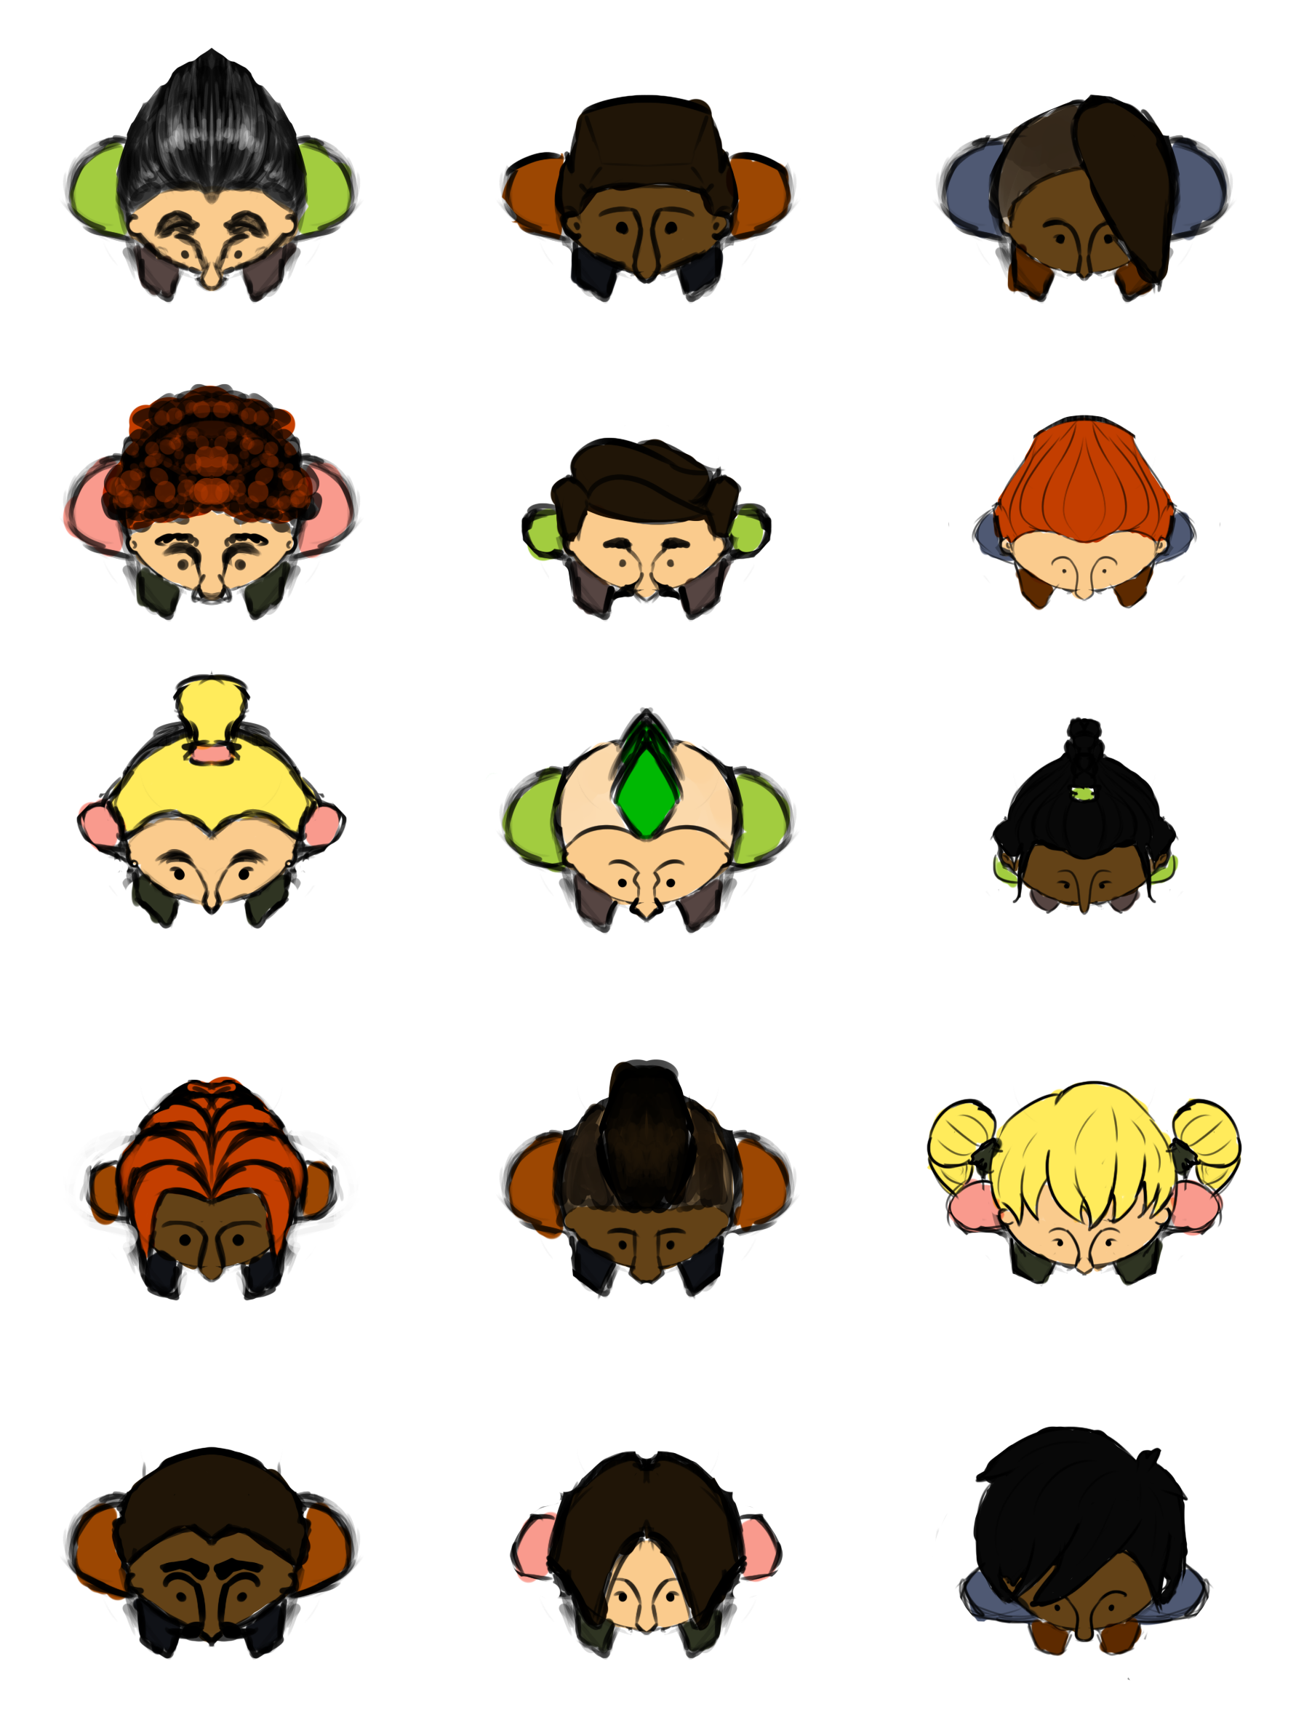

Where is the fun?
Hard fun: Frustration, fiero
People fun: Competition, schadenfreude
Serious fun: Flow state, repetition

Slide 7
Critiques
Interaction between two players
Speed increase
Power Ups

Slide 8


Questions?

